Slide 1
Chapter 5: Menus, SQLite

Slide 2
Learning Objectives
Use Menus, one menu item per activity
Use Sqlite to handle persistent data

Slide 3
Menus and Sqlite
Menus (in the action bar)
Menus using text, using icons
Using Sqlite to store persistent data (SQL syntax)
Menu item ➔ SQL operation (insert, delete, update, select)

Slide 4
Menus
When we start a project using the Basic Activity template, menu code is automatically generated.
menu_main.xml file is automatically generated.
Menu related methods are automatically coded in MainActivity.

Slide 5
menu_main.xml (1 of 2)
menu element
One item element inside
There could be more item elements added.
menu_main.xml defines a menu using an XML resource (and a menu can also be defined programmatically).

Slide 6
menu_main.xml (2 of 2)
<item
android:id="@+id/action_settings" android:title="@string/action_settings" android:orderInCategory="100" app:showAsAction="never"/>

Slide 7
Item Element / MenuItem Class
XML attribute of item | Method of MenuItem
android:title | setTitle
android:icon | setIcon
app:showAsAction | setShowAsAction

Slide 8
app:showAsAction
Possible values are: never, ifRoom, always, withText ...
ifRoom ➔ let the system decide to show it or not based on available space.
If there is not enough space, there will be a submenu so that the user can select it.

Slide 9
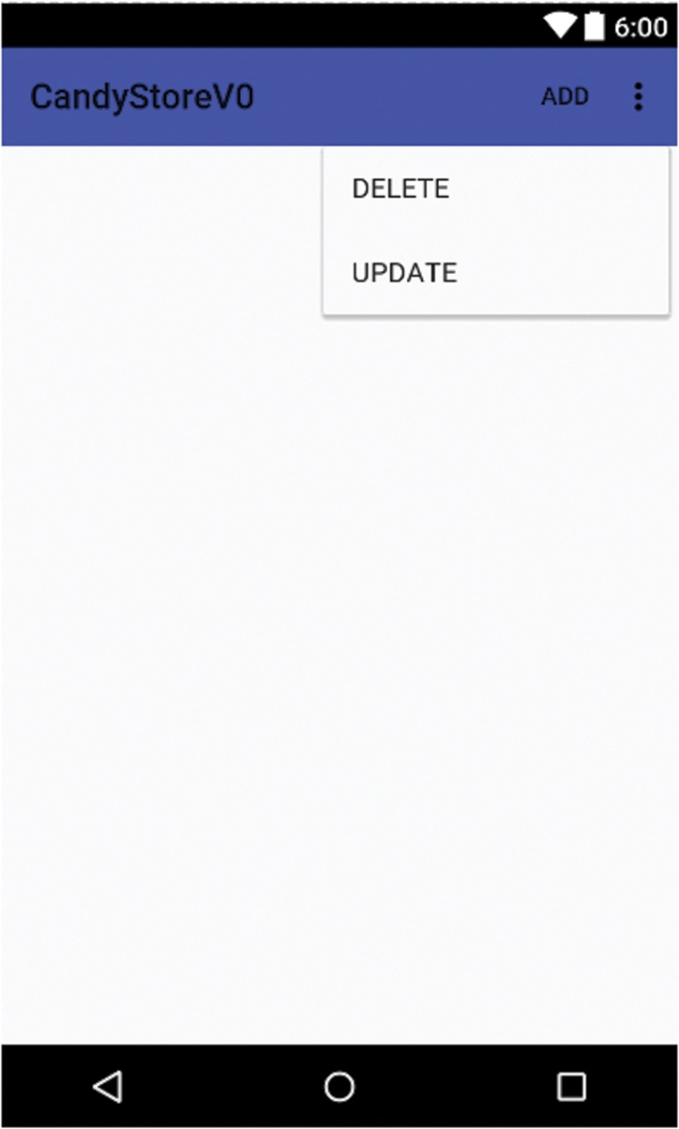
menu_main.xml (1 of 3)
We modify menu_main.xml so that it contains three menu item elements (add, delete, update).

Slide 10
menu_main.xml (2 of 3)
<item
android:id="@+id/action_add"
android:title="@string/add"
app:showAsAction="ifRoom"/>
<item android:id="@+id/action_delete" android:title="@string/delete" app:showAsAction="ifRoom"/>
<item
…

Slide 11
menu_main.xml (3 of 3)
add and delete strings are defined in strings.xml.
Ids are needed to identify the item the user selected (in the code).
ifRoom ➔ the item shows in the action bar if there is room for it.

Slide 12
Showing the Menu (1 of 2)
Inside MainActivity, onCreateOptionsMenu is automatically called: it displays the menu if there is one.
The menu items show on the right side of the action bar.

Slide 13
Showing the Menu (2 of 2)
The onCreateOptionsMenu method inflates menu_main.xml in order to create a menu and places that menu in the toolbar.
public boolean onCreateOptionsMenu( Menu menu ) { getMenuInflater( ).inflate(
R.menu.menu_main, menu ); return true;
}

Slide 14
Choosing from the Menu (1 of 3)
Processing a selection from the menu
Inside MainActivity, the onOptionsItemSelected method is automatically called when the user clicks on a menu item: we place our code here to process the user selection.

Slide 15
Choosing from the Menu (2 of 3)
onOptionsItemSelected method
public boolean onOptionsItemSelected( MenuItem item ) {
// Handle item selection
switch ( item.getItemId( ) ) { case R.id.action_add: …

Slide 16
Choosing from the Menu (3 of 3)
Add Log statements for feedback.
➔ we can identify what menu item was selected.

Slide 17
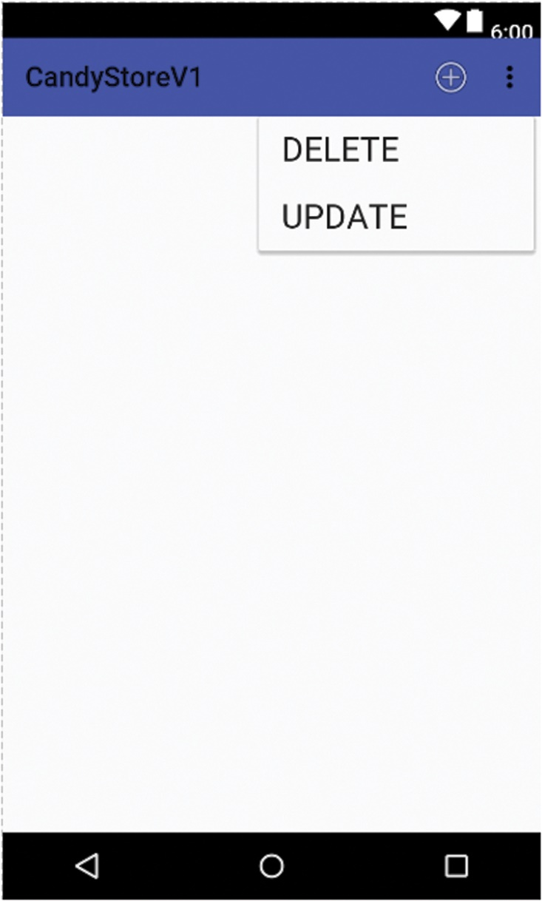
Using Icons in the Menu (1 of 2)
In Version 1, instead of text, we can use icons.

Slide 18
Using Icons in the Menu (2 of 2)
We need either to use existing icons from the Google library or create icons (for example png files) and place them in the drawable directory.
The size of the icons does not really matter; they will be automatically resized when placed inside the action bar.

Slide 19
menu_main.xml (1 of 4)
Inside the item element, we use the android:icon attribute and specify an icon resource.
We can use existing icons available in the Android library or create our own icons.

Slide 20
menu_main.xml (2 of 4)
Existing icons can be referenced using the following syntax and pattern:
@android:drawable/name_of_icon
We use three existing icons: ic_menu_add, ic_menu_delete, and ic_menu_edit.
android:icon="@android:drawable/ic_menu_add"

Slide 21
menu_main.xml (3 of 4)
…
<item android:id="@+id/action_add" android:title="@string/add"
android:icon=
"@android:drawable/ic_menu_add" app:showAsAction="ifRoom"/> …

Slide 22
menu_main.xml (4 of 4)
If both a title and an icon are specified inside an item element, the icon has higher preference and will show.
The title no longer shows.

Slide 23
Processing a Menu Selection
When the user selects a menu item, for example ADD, we want to start a new activity.
That new activity enables the user to enter data for a new candy and inserts that new candy in the candy database (using Sqlite).

Slide 24
Starting a New Activity
Two steps:
Create an intent to start an activity
Start the activity

Slide 25
Creating an Intent
Intent class
Intent( Context, Class ) constructor:
Intent insertIntent = new Intent( this, InsertActivity.this );

Slide 26
Starting an Activity
Once we have an Intent, we use the startActivity method of the Context class (inherited by the Activity class ...)
startActivity( insertIntent );

Slide 27
Processing a Menu Selection (1 of 2)
If the new activity is an InsertActivity, to start it:
Intent insertIntent = new Intent( this, InsertActivity.class );
this.startActivity( insertIntent );

Slide 28
Processing a Menu Selection (2 of 2)
public boolean onOptionsItemSelected( MenuItem item ) { switch ( item.getItemId( ) ) { case R.id.action_add: Intent insertIntent = new Intent(
this, InsertActivity.class ); this.startActivity( insertIntent ); …

Slide 29
Adding a Candy
We neeed to create and code the InsertActivity class and provide a View (an XML layout file) for it
➔ Create InsertActivity.java
➔ Create activity_insert.xml

Slide 30
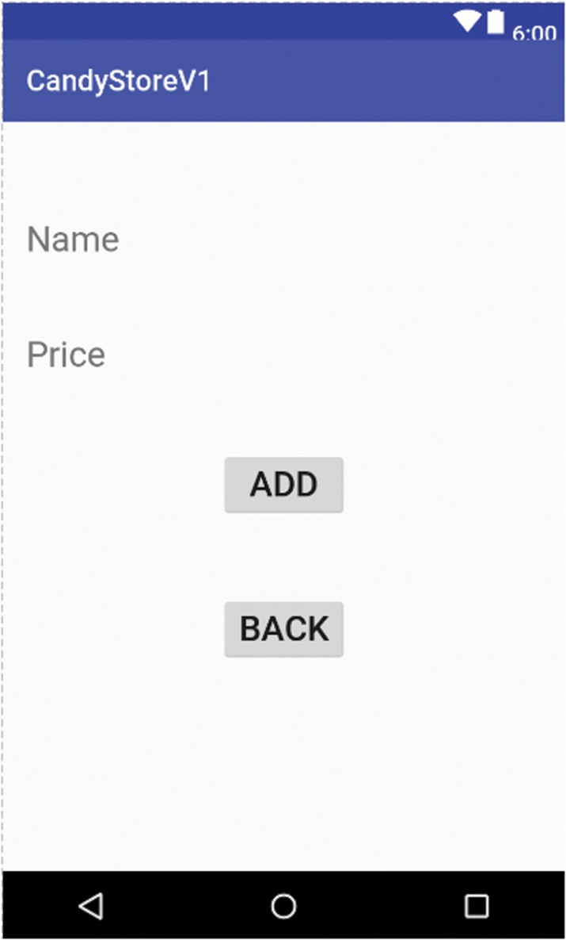
View for Adding a Candy

Slide 31
activity_insert.xml (1 of 2)
We use a RelativeLayout.
We include two pairs of TextView/EditText.
We include two Buttons (one to insert the data, one to go back to the main activity).
We use ids to position the elements and retrieve them later using findViewById in InsertActivity class.

Slide 32
activity_insert.xml (2 of 2)
See Example 5.8.
We also include a few Strings in the strings.xml file that we use in activity_insert.xml.

Slide 33
AndroidManifest.xml
We need to update AndroidManifest.xml, add an activity element for the insert activity.
<activity
android:name=".InsertActivity" android:label="@string/app_name" >
</activity>

Slide 34
InsertActivity Methods (1 of 2)
The goBack method takes us back to main activity.
➔ It pops the current activity off the stack.
public void goBack( View v ) {
this.finish( );
}

Slide 35
InsertActivity Methods (2 of 2)
The insert method retrieves user input, inserts it in the candy database, and clears the EditText fields.
We use findViewById to retrieve EditTexts, then retrieve user input.
➔ to insert in database, we need to access Sqlite.

Slide 36
InsertActivity: insert Method (1 of 3)
public void insert( View v ) { // retrieve name and price
// insert new candy in database // clear data in the two EditTexts }

Slide 37
InsertActivity: insert Method (2 of 3)
// Retrieve name and price EditText nameEditText =
( EditText) findViewById( R.id.input_name ); EditText priceEditText =
( EditText) findViewById( R.id.input_price ); String name = nameEditText.getText( ).toString( ); String priceString =
priceEditText.getText( ).toString( );

Slide 38
InsertActivity: insert Method (3 of 3)
// insert new candy in database // clear data nameEditText.setText( "" ); priceEditText.setText( "" );

Slide 39
Sqlite
In Version 2, we perform SQL operations.
We create a database.
We create a table inside that database.
We insert data in that table.

Slide 40
Candy Table (1 of 2)
We keep it simple and store the following data:
Candy id, candy name, and candy price
➔ 3 columns (int auto increment, string, double or float)

Slide 41
Candy Table (2 of 2)
Possible data in the candy table:
Id | Name | Price
1 | Chocolate fudge | 1.99
2 | Walnut chocolate | 2.99
3 | Hazelnut chocolate | 3.49

Slide 42
Candy Class
As part of the Model, we write a Candy class to encapsulate a Candy.
Three instance variables:
id, an int
name, a String
price, a double
Constructor, accessors, mutators, toString.
See Example 5.14.

Slide 43
Sqlite Related Classes
SQLiteOpenHelper: we extend this abstract class to manage a database along with its version.
We must override its onCreate and onUpgrade methods.

Slide 44
DatabaseManager
As part of our Model, we code the DatabaseManager class.
It contains methods to perform SQL operations related to the Candy class.

Slide 45
SQLiteOpenHelper
public class DatabaseManager extends SQLiteOpenHelper { private static final String DATABASE_NAME =
"candyDB"; private static final int DATABASE_VERSION = 1; private static final String TABLE_CANDY = "candy"; // other constants for column names

Slide 46
onCreate and onUpgrade
Inside onCreate: create the candy table
Inside onUpgrade: drop the candy table and call onCreate to recreate it

Slide 47
Sqlite Related Classes
SQLiteDatabase: includes methods to execute SQL statements: insert, delete, update, select
Both onCreate and onUpgrade include an SQLiteDatabase parameter.

Slide 48
SQLiteDatabase: execSql Method
void execSql( String sql )
Executes an SQL query that does not return data (for example, create, insert, delete, update – not select)

Slide 49
onCreate Method
// create candy table
public void onCreate( SQLiteDatabase db ) {
// build sql create statement
String sqlCreate = "create table " + TABLE_CANDY +
"( " + ID; sqlCreate += " integer primary key autoincrement, " +
NAME;
sqlCreate += " text, " + PRICE + " real )";
db.execSQL( sqlCreate );
}

Slide 50
onUpgrade Method
// drop candy table, recreate it
public void onUpgrade( SQLiteDatabase db, int oldVersion, int newVersion ) { // Drop old table if it exists db.execSQL( "drop table if exists " +
TABLE_CANDY ); // Re-create table(s) onCreate( db );
}

Slide 51
DatabaseManager Methods (1 of 2)
Inside DatabaseManager, we also provide methods to:
Insert a candy
Delete a candy based on its id
Update a candy (name and price, based on id)

Slide 52
DatabaseManager Methods (2 of 2)
We add more methods to:
Select a candy based on its id
Select all the candies

Slide 53
Insert Method (1 of 2)
One parameter, a Candy reference (to a Candy object that we insert in the candy table)
Get a reference to our SQLiteDatabase
Define the insert SQL String
Execute the insert SQL statement

Slide 54
Insert Method (2 of 2)
public void insert( Candy candy ) { // insert candy
}

Slide 55
Accessing the Database
We use the getWritableDatabase method of the SQLiteOpenHelper class.
SQLiteDatabase getWritableDatabase( )
➔ It creates or opens a database that will be used for reading and writing.
➔ The first time this method is called, onCreate, onUpgrade, and onOpen are automatically called.

Slide 56
Insert Method (1 of 5)
public void insert( Candy candy ) {
// Database Manager extends SQLiteOpenHelper
// Thus, this “is a” SQLiteOpenHelper
SQLiteDatabase db = this.getWritableDatabase( );
// construct insert SQL String
// execute the SQL query
// close db
}

Slide 57
Insert Method (2 of 5)
To execute the SQL insert, we call the execSQL method with db (the SQLiteDatabase reference), passing the appropriate SQL String.

Slide 58
Insert Method (3 of 5)
public void insert( Candy candy ) {
SQLiteDatabase db = this.getWritableDatabase( );
String sqlInsert = "…";
db.execSQL( sqlInsert );
db.close( );
}

Slide 59
Insert Method (4 of 5)
The candy table has three columns (id, name, price).
The type of the first column (id) is int auto-increment.
➔ We use null.
We use the name and price of the candy parameter for the second and third columns.

Slide 60
Insert Method (5 of 5)
public void insert( Candy candy ) {
SQLiteDatabase db = this.getWritableDatabase( );
String sqlInsert = "insert into " +
TABLE_CANDY; sqlInsert += " values( null, '" + candy.getName( ); sqlInsert += "', '" + candy.getPrice( ) + "' )"; db.execSQL( sqlInsert ); db.close( );
}

Slide 61
Update and Delete (1 of 2)
The updateById and deleteById methods are similar to the insert method.
updateById takes three parameters: an int for the id, a String for the updated name, and a double for the updated price.
deleteById takes one parameter, an int representing a Candy id.

Slide 62
Update and Delete (2 of 2)
Similar to the insert method:
Get a reference to the SQLiteDatabase
Construct the SQL query as a String
Execute it

Slide 63
More Methods
We provide methods to select a candy based on its id and to select all the candies from the candy table.

Slide 64
selectById Method (1 of 2)
public Candy selectById( int id ) {
// select the row in the candy table
// whose id value is id
// return a reference to the Candy object
// stored in that row
}

Slide 65
selectById Method (2 of 2)
We need to execute an SQL select query.
Since we select based on the value of the primary key (id) of the table, the select query will return a table of 0 or 1 row (a select query returns a table).
If it returns a table of 1 row, we need to access the columns of that row.

Slide 66
rawQuery Method
The rawQuery method executes an SQL select query.
public Cursor rawQuery( String sql, String [ ] selectionArgs )
If sql String contains ? placeholders, then we provide values in selectionArgs, otherwise selectionArgs is null.

Slide 67
Sqlite Related Classes/Interfaces
The Cursor interface encapsulates a table returned by a select statement (a select statement returns a table).
It provides methods to loop through the rows and columns of that table.

Slide 68
Cursor Interface (1 of 2)
Move this Cursor to first row:
boolean moveToFirst( )
Move this Cursor to the next row:
boolean moveToNext( )
These methods return false if there is not another row to process.

Slide 69
Cursor Interface (2 of 2)
To retrieve the value of a column of the current row, we use the methods:
DataType getDataType( int columnIndex )
For example:
int getInt( int columnIndex )
double getDouble( int columnIndex )
String getString( int columnIndex )
…

Slide 70
selectById Method (1 of 6)
SQLiteDatabase db = this.getWritableDatabase( );
// construct sqlQuery, a select query
// call rawQuery to execute the select query
Cursor cursor = db.rawQuery( sqlQuery, null );
// process the results
// build a Candy object, then return it

Slide 71
selectById Method (2 of 6)
// construct sqlQuery, a select query
String sqlQuery = "select * from " + TABLE_CANDY;
sqlQuery += " where " + ID + " = " + id;

Slide 72
selectById Method (3 of 6)
// process the result of the query
Candy candy = null;
if( cursor.moveToFirst( ) ) candy = new Candy(
Integer.parseInt( cursor.getString( 0 ) ),
cursor.getString( 1 ),
cursor.getDouble( 2 ) );
return candy;

Slide 73
selectById Method (4 of 6)
select * from candy
Build and return an ArrayList of Candy objects
Loop through all the rows using moveToNext method

Slide 74
selectById Method (5 of 6)
public ArrayList<Candy> selectAll( ) {
// select all the rows in the candy table
// return an ArrayList of Candy objects
}

Slide 75
selectById Method (6 of 6)
ArrayList<Candy> candies = new ArrayList<Candy>( );
while( cursor.moveToNext( ) ) { Candy currentCandy = new Candy( Integer.parseInt(
cursor.getString( 0 ) ), cursor.getString( 1 ), cursor.getDouble( 2 ) ); candies.add( currentCandy );
}
db.close( );
return candies;

Slide 76
InsertActivity Class (1 of 2)
Now that our Model is finalized, we add code to the InsertActivity class (its insert method) to actually add a candy to the database.
We include a DatabaseManager instance variable.
We instantiate it inside the onCreate method.

Slide 77
InsertActivity Class (2 of 2)
Inside the insert( View ) method, we call the insert method of the DatabaseManager class.
We show a Toast to confirm that the candy was added.

Slide 78
Toast (1 of 4)
A Toast is a small visual element that is displayed for a short amount of time.
It automatically disappears after that time.
The Toast class is in the android.widget package.

Slide 79
Toast (2 of 4)
To create a Toast, use one of the static makeText methods:
public static Toast makeText( Context context, CharSequence text, int duration )

Slide 80
Toast (3 of 4)
context ➔ this (an Activity "is a" Context)
text ➔ what we want to display (a String "is a" CharSequence)
duration: number of seconds (use the LENGTH_SHORT (3 seconds ?) or LENGTH_LONG (5 seconds ?) constants of the Toast class)

Slide 81
Toast (4 of 4)
The makeText method creates a Toast but it does not show it.
We call the show instance method to show it.
public void show( )
Toast.makeText( this, "Candy added", Toast.LENGTH_LONG ).show( );

Slide 82
Testing the App (1 of 2)
When we run the app, enter some data and click on the ADD icon, the Toast message appears.
If we want to check that a new row is added to the candy table, we can call the selectAll method of the DatabaseManager class and loop through the resulting ArrayList of Candy objects.

Slide 83
Testing the App (2 of 2)
We can write these statements at the end of the insert method and check the output in Logcat:
ArrayList<Candy> candies = dbManager.selectAll( );
for( Candy candy : candies ) Log.w( "MainActivity", "candy = " + candy.toString( ) );

Slide 84
Deleting a Candy
In Version 3, we enable the user to delete a candy from the database.
We create and code the DeleteActivity class and provide a View for it.
➔ DeleteActivity.java

Slide 85
Update the Menu Selection
public boolean onOptionsItemSelected( MenuItem item ) { switch ( item.getItemId( ) ) { …
case R.id.action_delete: Intent deleteIntent = new Intent(
this, DeleteActivity.class ); this.startActivity( deleteIntent ); …

Slide 86
Deleting a Candy (1 of 4)
We add an activity element to the AndroidManifest.xml file for DeleteActivity.

Slide 87
Deleting a Candy (2 of 4)
We provide a list of radio buttons, one per candy.
The user selects one to delete the corresponding candy.
We do not know in advance how many candies there are in the database.
➔ We need to build the GUI by code.

Slide 88
Deleting a Candy (3 of 4)
The list of radio buttons may be too big for the screen.
➔ We place it inside a ScrollView.

Slide 89
Deleting a Candy (4 of 4)
We could go back to the previous activity (the main screen) when the user selects a candy to delete.
But maybe the user wants to delete more than one candy ... so we stay on this screen.
… and provide a "back" button that takes the user back to the main screen.
We place the ScrollView and the "Back" button inside a Relative Layout.

Slide 90
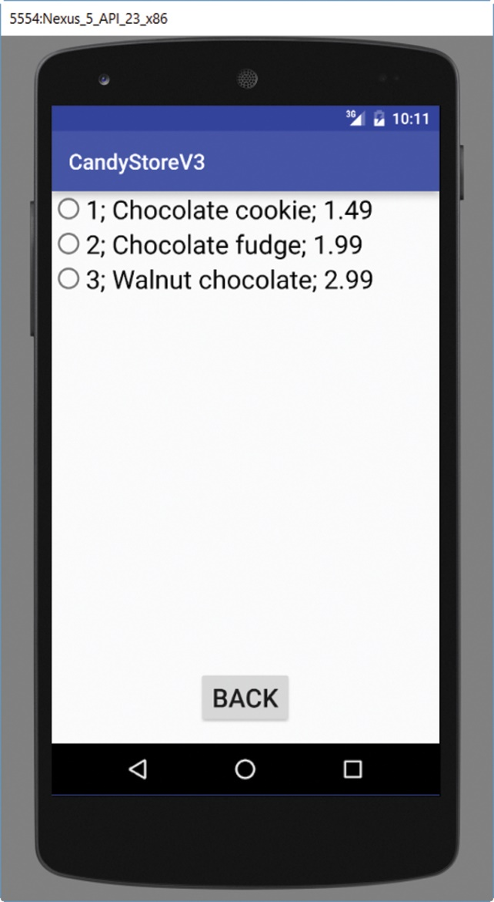
Deleting a Candy: GUI

Slide 91
Deleting a Candy
We code a separate method, updateView, to code the GUI.
When the user selects a candy to delete, not only do we delete it from the database, but we also refresh the current screen by calling updateView.

Slide 92
updateView Method (1 of 4)
We call selectAll from the DatabaseManager class.
ArrayList<Candy> candies = dbManager.selectAll( );

Slide 93
updateView Method (2 of 4)
We loop through the results and build the radio buttons:
for ( Candy candy : candies ) { RadioButton rb = new RadioButton( this ); …

Slide 94
updateView Method (3 of 4)
We set the id of each radio button to the id of the candy.
We set the text of each radio button to a String representation of the candy by calling the toString method of the Candy class.

Slide 95
updateView Method (4 of 4)
We loop through the results and build the radio buttons:
rb.setId( candy.getId( ) );
rb.setText( candy.toString( ) );
// add rb to a RadioGroup group
// in order to make them mutually exclusive
group.addView( rb );

Slide 96
Event Handling (1 of 4)
We need to set up event handling.
We code a private class that implements the RadioGroup.OnCheckedChangeListener interface.
That class overrides the onCheckedChanged method.

Slide 97
Event Handling (2 of 4)
The onCheckedChanged method includes a parameter that represents the id of the radio button selected.
… which is the id of the candy that we need to delete.

Slide 98
Event Handling (3 of 4)
public void onCheckedChanged(
RadioGroup group,
int checkedId ) { // delete candy from database dbManager.deleteById( checkedId );
…

Slide 99
Event Handling (4 of 4)
// confirm to the user
Toast.makeText( DeleteActivity.this, "Candy deleted", Toast.LENGTH_SHORT ).show( );
// update screen (the list of candies has changed)
updateView( );

Slide 100
Updating a Candy (1 of 2)
In Version 4, we enable the user to update a candy: change its name or its price.
We create and code the UpdateActivity class ➔ UpdateActivity.java
The View is also dynamic ➔ we build it by code.
We update the AndroidManifest.xml file.

Slide 101
Updating a Candy (2 of 2)
The list of candies to display for potential editing may be too big for the screen.
➔ We place it inside a ScrollView.

Slide 102
Update the Menu Selection
public boolean onOptionsItemSelected( MenuItem item ) { switch ( item.getItemId( ) ) { …
case R.id.action_delete: Intent updateIntent = new Intent(
this, UpdateActivity.class ); this.startActivity( updateIntent ); …

Slide 103
Updating a Candy
We add an activity element to the AndroidManifest.xml file for UpdateActivity.
Inside UpdateActivity, we need a DatabaseManager instance variable to perform database operations.

Slide 104
Updating a Candy—GUI (1 of 3)
Four elements per Candy:
One TextView (id)
One EditText (decription)
One EditText (price)
One Button ➔ commit the update
The user can update description and price.

Slide 105
Updating a Candy—GUI (2 of 3)
As in the delete activity, we could provide a back button to go back to the main activity.
However, there is no need for it: the user can use the device's back button, which pops the current activity off the stack.

Slide 106
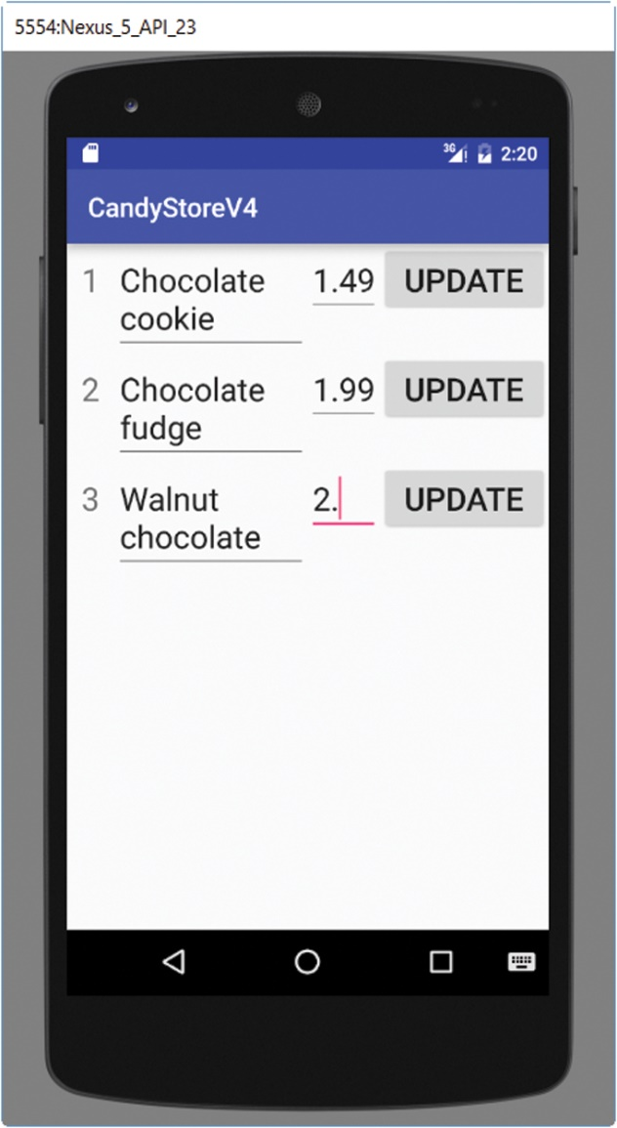
Updating a Candy—GUI (3 of 3)

Slide 107
Updating a Candy
As in the delete activity, we code a separate method, updateView, to code the GUI.
When the user edits a candy and commits the update, not only do we update it in the database, but we also refresh the current screen by calling updateView.

Slide 108
updateView Method (1 of 14)
We call selectAll from the DatabaseManager class:
ArrayList<Candy> candies = dbManager.selectAll( );

Slide 109
updateView Method (2 of 14)
We place everything in a GridLayout, itself in a ScrollView.
The GridLayout has four columns (one TextView, two EditTexts , one Button), and as many rows as there are candies.

Slide 110
updateView Method (3 of 14)
GridLayout grid = new GridLayout( this );
grid.setRowCount( candies.size( ) );
grid.setColumnCount( 4 );

Slide 111
updateView Method (4 of 14)
We create three arrays: one for the TextViews, one for the Buttons, and one two-dimensional array for the EditTexts.

Slide 112
updateView Method (5 of 14)
We loop through all the candies to build the grid.
We need to retrieve the width of the screen to size the width of the four components properly.

Slide 113
updateView Method (6 of 14)
Point size = new Point( );
getDefaultManager( ).getDefaultDisplay( ) .getSize( size );
// Capture the width of screen
int width = size.x

Slide 114
updateView Method (7 of 14)
We set the text inside the TextView of each row to the id of the candy:
ids[i] = new TextView( this );
ids[i].setText( "" + candy.getId( ) );

Slide 115
updateView Method (8 of 14)
We set the text inside the EditTexts of each row to the name and price of the candy
namesAndPrices[i][0] = new EditText( this );
namesAndPrices[i][1] = new EditText( this );
namesAndPrices[i][0]
.setText( candy.getName( ) );
namesAndPrices[i][1]
.setText( "" + candy.getPrice( ) );

Slide 116
updateView Method (9 of 14)
We give a unique id to each EditText:
namesAndPrices[i][0]
.setId( 10 * candy.getId( ) );
namesAndPrices[i][1]
.setId( 10 * candy.getId( ) + 1 );

Slide 117
updateView Method (10 of 14)
We set the text inside the Button of each row to UPDATE, and give each button the id of the candy (so we can match the candy to update with the button clicked):
buttons[i] = new Button( this );
buttons[i].setText( "Update" );
buttons[i].setId( candy.getId( ) );

Slide 118
updateView Method (11 of 14)
We set up event handling for each button:
buttons[i].setOnClickListener( bh);
bh is an object of class ButtonHandler
We need to code that class.

Slide 119
updateView Method (12 of 14)
We add the four components to the current row of the GridLayout with the following space allocation:
Id: 10%
Name: 50%
Price: 15%
Button: 25%

Slide 120
updateView Method (13 of 14)
We add the components
// width is retrieved dynamically
// current TextView, 10% of width, minimal height
grid.addView( ids[i], width / 10, ViewGroup.LayoutParams.WRAP_CONTENT );
Similarly, we add the EditTexts (two per row) and the Button (one per row).

Slide 121
updateView Method (14 of 14)
Outside the loop:
We add the GridLayout to the ScrollView
scrollView.addView( grid );
We set the ScrollView as the content View for this activity:
setContentView( scrollView );

Slide 122
Update: Event Handling (1 of 8)
private class ButtonHandler implements
View.OnClickListener { public void onClick( View v ) { …

Slide 123
Update: Event Handling (2 of 8)
Inside the onClick method of ButtonHandler:
We retrieve the id of the candy that is being updated.
We retrieve its edited name and price.
We update the database.
We show a Toast for feedback.
We update the view.

Slide 124
Update: Event Handling (3 of 8)
We first retrieve the id of the candy that is being updated.
The View parameter v is a reference to the button that was clicked.
Earlier, we gave each button an id, the id of the candy for that row.
int candyId = v.getId( );

Slide 125
Update: Event Handling (4 of 8)
We then get a reference to the two EditTexts:
nameET = ( EditText )
findViewById( 10 * candyId );
priceET = ( EditText )
findViewById( 10 * candyId + 1 );

Slide 126
Update: Event Handling (5 of 8)
Then we retrieve the candy’s edited name and price:
String name = nameET.getText( ).toString( );
String priceString =
priceET.getText( ).toString( );
// we need to convert priceString to a double

Slide 127
Update: Event Handling (6 of 8)
Next, we update the database.
Inside try block:
Double price = Double.parseDouble( priceString );
dbManager.updateById( candyId, name, price );

Slide 128
Update: Event Handling (7 of 8)
We show a Toast for feedback:
Toast.makeText( UpdateActivity.this, "Candy updated", Toast.LENGTH_SHORT )
.show( );

Slide 129
Update: Event Handling (8 of 8)
Finally, we update the view
updateView( );

Slide 130
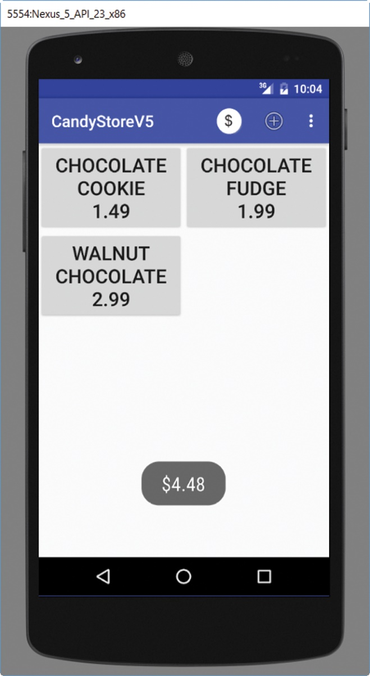
Cash Register (1 of 3)
In Version 5, we enable the user to use a cash register on the first screen.
As the user clicks on candies, we show a running total in a Toast.

Slide 131
Cash Register (2 of 3)
We display a grid of buttons, one per candy.
When the user clicks on a button, we update the total and show it in a Toast.

Slide 132
Cash Register (3 of 3)
Thus, when the user clicks on a button, we need to know what candy is selected.
An easy way to do that is to extend the Button class and create a CandyButton class (see Example 5.23).
A CandyButton is a Button that has a Candy instance variable.
We provide a getPrice method for convenience.

Slide 133
CandyButton Class
// import statements
public class CandyButton extends Button { private Candy candy; public CandyButton( Context context, Candy newCandy ) { super( context ); candy = newCandy; } public double getPrice( ) { return candy.getPrice( ); } }

Slide 134
Cash Register
We create a new icon (ic_reset.png), and place it in the drawable directory.
We add an item in the menu.
We run the cash register inside MainActivity.
When the user select the icon for the cash register (action_reset id), we reset the total to 0.

Slide 135
menu_main.xml (1 of 2)
Since we made our own icon and place it in the drawable directory, we use the syntax:
android:icon="@drawable/name_of_icon "
android:icon="@drawable/ic_reset"

Slide 136
menu_main.xml (2 of 2)
<menu …> <item android:id="@+id/action_reset" android:title="@string/reset" android:icon="@drawable/ic_reset" app:showAsAction="ifRoom"/> <item android:id="@+id/action_add" …

Slide 137
Cash Register—MainActivity (1 of 2)
Inside onOptionsItemSelected method:
case R.id.action_reset:
total = 0.0;
return true;
Note that we stay in this activity (MainActivity).

Slide 138
Cash Register—MainActivity (2 of 2)
The updateView method displays the GUI.
One Button for each candy, two per row inside a GridLayout.
The GridLayout is inside a ScrollView (we do not know in advance how many buttons we have).

Slide 139
ScrollView
An easy way to provide a ScrollView is to replace the RelativeLayout inside content_main.xml with a ScrollView element.
We give it an id so that we can retrieve it inside the MainActivity class.
We also eliminate the padding inside the ScrollView.

Slide 140
content_main.xml
<?xml version="1.0" encoding="utf-8"?> <ScrollView …
android:id="@+id/scrollView"> </ScrollView>

Slide 141
Cash RegisterMainActivity
We include a DatabaseManager instance variable to perform database operations:
private DatabaseManager dbManager;

Slide 142
Cash Register—updateView (1 of 4)
ArrayList<Candy> candies = dbManager.selectAll( );
The GridLayout has two columns:
and ( candies.size( ) + 1 ) / 2 rows
If there are 6 candies ➔ 7 / 2 = 3 rows
If there are 7 candies ➔ 8 / 2 = 4 rows

Slide 143
Cash Register—updateView (2 of 4)
We retrieve the width of screen; the button width is the width of screen divided by 2 (there are two buttons per row).
We create an array of candyButtons:
CandyButton [ ] buttons = new CandyButton[candies.size( )];
For each candy, we add a CandyButton to the GridLayout.

Slide 144
Cash Register—updateView (3 of 4)
buttons[i] = new CandyButton( this, candy );
buttons[i].setText( candy.getName( ) + "\n" + candy.getPrice( ) );
We set up event handling
buttons[i].setOnClickListener( bh );
bh is an object of type ButtonHandler (which implements View.OnClickListener)

Slide 145
Cash Register—updateView (4 of 4)
We add each button to GridLayout.
The width of each button is buttonWidth.
Its height is minimal height.
grid.addView( buttons[i], buttonWidth, GridLayout.LayoutParams.WRAP_CONTENT );

Slide 146
updateView Method
Outside the loop:
We add the GridLayout to the ScrollView.
scrollView.addView( grid );
We set the ScrollView as the content View for this activity.
setContentView( scrollView );

Slide 147
Cash Register: Event Handling (1 of 4)
Inside the onClick method of ButtonHandler:
We retrieve the price of the candy that is purchased.
We add it to the total.
We show a Toast for feedback.

Slide 148
Cash Register: Event Handling (2 of 4)
We retrieve the price of the candy that is purchased.
The View parameter of onClick, v, is a reference to the button that was clicked, which is a CandyButton.

Slide 149
Cash Register: Event Handling (3 of 4)
We cast v to a CandyButton.
( CandyButton ) v
We add the price of the candy selected to the total.
total += ( ( CandyButton ) v ).getPrice( );

Slide 150
Cash Register: Event Handling (4 of 4)
We format total:
String pay =
NumberFormat.getCurrencyInstance( )
.format( total );
We show a Toast for feedback:
Toast.makeText( MainActivity.this, pay, Toast.LENGTH_SHORT ).show( );

Slide 151
Chapter Summary
Menu, menu items (text, icon)
SQLite
Toast
Building a GUI programmatically
ScrollView

